Slide 1
Smart Music Discovery
Improving Gaana's Recommendations

Slide 2
Why Recommendations are Essential
PERSONALIZATION
Music apps can tailor content to individual tastes, by understanding user preference.
USER ENGAGEMENT
Keeps users engaged with the platform for longer periods, increasing the likelihood of continued subscription or usage.
DISCOVERABILITY
Recommendations help users discover new music that they might not find on their own
RETENTION
By providing a better listening experience, recommendations help retain users and reduce churn rates.

Slide 3
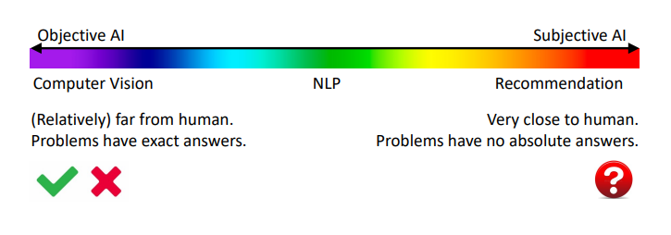
OBJECTIVE AI VS SUBJECTIVE AI
Recommendation is unique in the AI family
Recommendation is most close to human among all AI tasks
Recommendation is a very representative Subjective AI
Thus, leads to many unique challenges in recommendation research

Slide 4
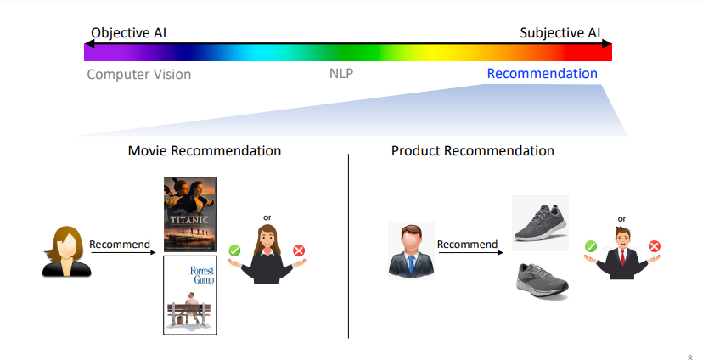
OBJECTIVE AI VS SUBJECTIVE AI

Slide 5
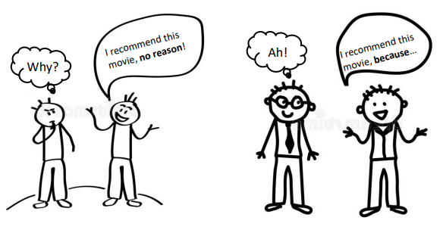
SUBJECTIVE AI NEEDS EXPLAINABILITY
In many cases, it doesn’t matter what you recommend, but how you explain your recommendation
How do humans make recommendation?

Slide 6
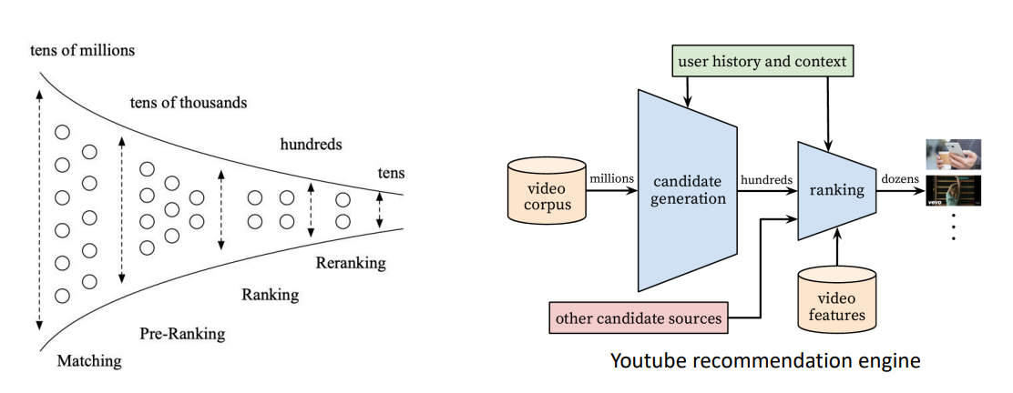
A Bird’s View of Traditional RecSys

Slide 7
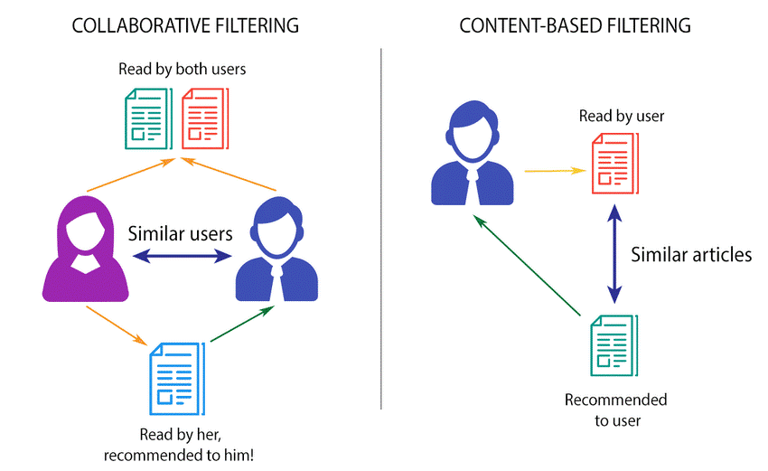

Exploring Industry Standard Filtering methods
Collaborative filtering
Content based filtering
Recommends items based on users with similar taste
Recommends items based on content similarity

Slide 8
Working of Content-based Filtering
ITEM PROFILES
Defined by features like genre, director, cast, release year, and descriptions.
UER PROFILES
User preferences, ratings, and favorite genres/artists.
MATCHING
Matches item profiles with the user profile; items aligning with user interests are recommended.
SCORING & RANKING
Each item is scored by its similarity to the user’s profile, and the system ranks and presents the top recommendations.

Slide 9
Working of Collaborative filtering
USER ITEM INTERACTION
Each interaction, such as a rating, view, or like, is recorded and used to understand user preferences
USER SIMILARITY
The system identifies users who have similar preferences based on their past interactions.
Recommendation
The system recommends items that similar users have liked but that the current user has not yet interacted with

Slide 10
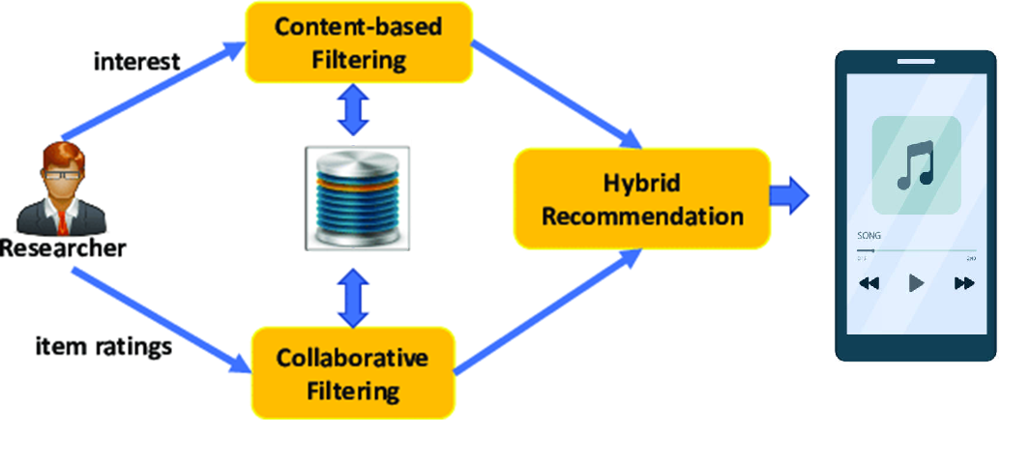
Hybrid solution
Notes:
Hybrid approaches
Many recommendation systems combine content-based and collaborative filtering techniques.
Hybrid models aim to leverage the strengths of both approaches.
For instance, hybrid systems can use content-based features alongside collaborative filtering scores.

Slide 11
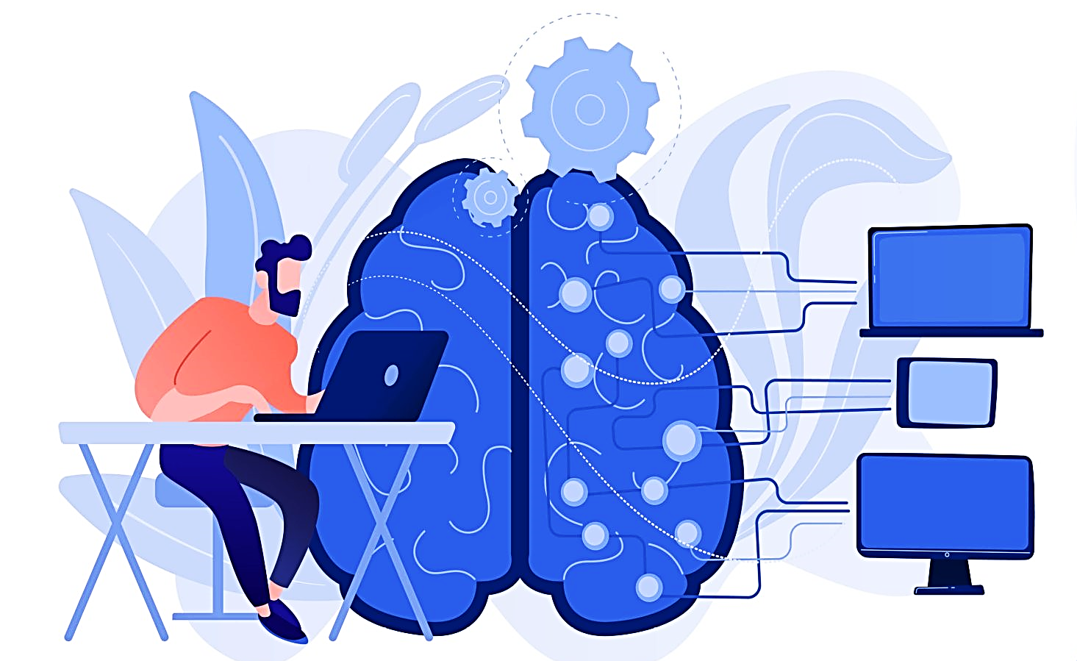
WHAT ARE LLMs
Large Language Models (LLMs) are advanced AI systems designed to understand and generate human language.
Trained on vast amounts of text data, they can perform tasks like translation, summarization, and conversation.
Examples include GPT-4 and BERT, which use deep learning techniques to achieve high language proficiency.

Slide 12
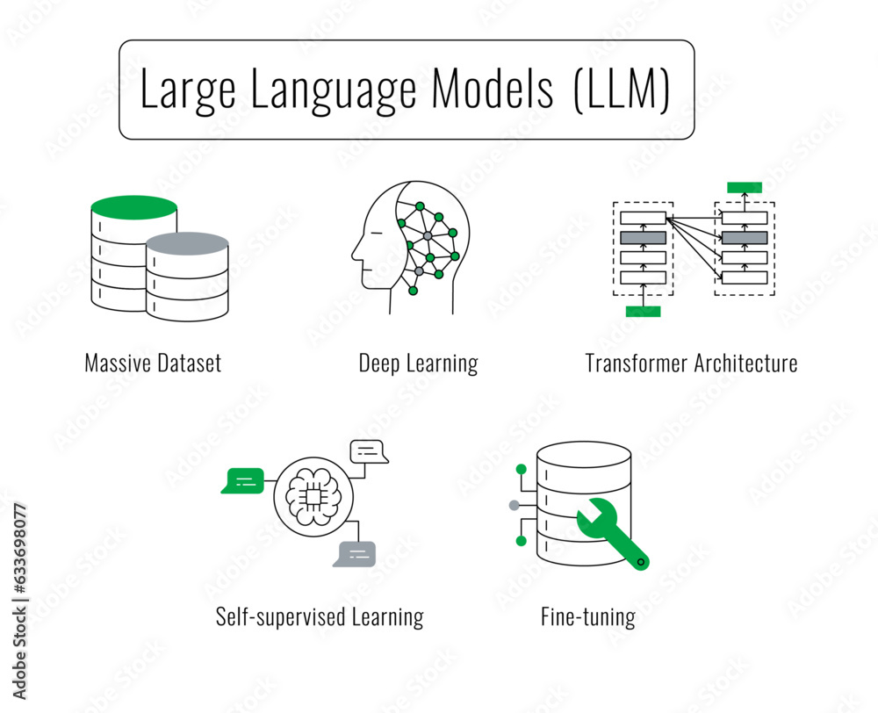
How to Categorize LLM-based Recommendation
The Role of LLM in Recommendation
LLM as RecSys
LLM in RecSys
e.g., LLM as a feature extractor for recommender systems
Typical Recommendation Tasks
Rating Prediction, Sequential Recommendation, Direct Recommendation, etc.

Slide 13
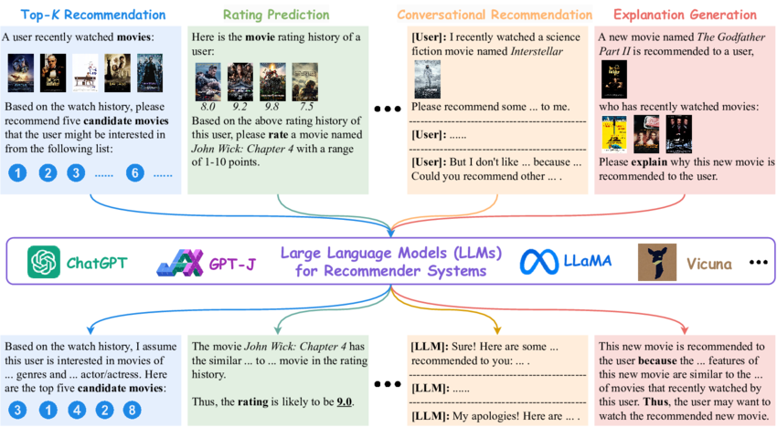
TWO BROAD CATEGORIES OF RECOMMENDATION TASKS

Slide 14
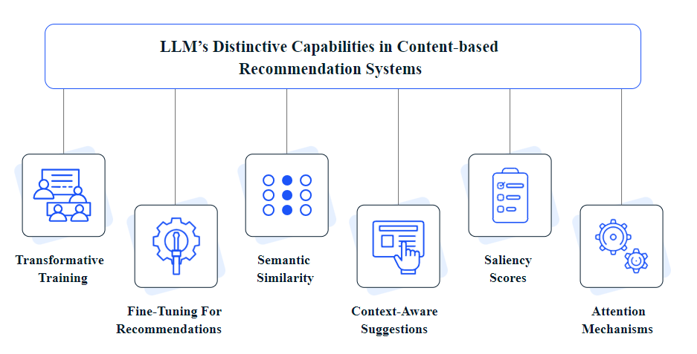
How LLMs are transforming content-based recommendation systems in entertainment platforms?
Notes:
1. **Transformative training**:
- Large Language Models (LLMs) like GPT-3 or PaLM are trained using a special kind of technology called transformers. These models are fed massive amounts of text (think of reading thousands of books) so they can learn the patterns and meanings in human language. This deep learning process helps them become really good at understanding and processing natural language.
2. **Extracting meaningful features from text**:
- In recommendation systems (like those suggesting movies or songs), the text describing items (like movie plots or song lyrics) is crucial. LLMs can read and understand these texts to identify important details. For example, a model called BERT can understand the meaning of each word based on the words around it, which helps in capturing both the small details and the bigger picture.
3. **Fine-tuning for recommendations**:
- After being trained on a lot of general text, LLMs can be adjusted (fine-tuned) to be better at specific tasks, like making recommendations. This means teaching the model to understand the essence of items (like what makes a movie thrilling) so it can suggest similar content that users might enjoy.
4. **Semantic similarity**:
- LLMs can compare different pieces of content (like movies or songs) by understanding their underlying themes or tones, not just surface-level keywords. This allows the system to recommend content that feels similar, even if the genres are different.
5. **Context-aware suggestions**:
- Traditional systems might just match keywords to make recommendations. LLMs go beyond that by understanding the context and nuances. For instance, if someone likes a suspenseful movie, the model can suggest other suspenseful movies even if they belong to different genres.
6. **Attention mechanisms**:
- LLMs use something called attention mechanisms to focus on the most important parts of the text. This means they can "pay attention" to key words or phrases that really define what an item is about, making the recommendations more accurate.
7. **Saliency scores**:
- LLMs can calculate how important each word in a description is for understanding what the item is. By highlighting these important words, users can better understand why a particular recommendation was made.
8. **Information and Content Literacy (ICL)**:
- LLMs are good at understanding context and giving relevant answers based on what they’re given. ICL refers to the model’s ability to adapt its responses to the specific situation, rather than just spitting out generic answers. This makes the responses more accurate and personalized.
9. **Enhancing reasoning with Chain-of-Thought (CoT) and self-consistency**:
- Chain-of-Thought (CoT) is a method that helps LLMs think more logically by guiding them step-by-step through a reasoning process. Self-consistency is like double-checking the reasoning process by having multiple versions of the model vote on the best answer, which helps make the conclusions more reliable.
10. **Prediction of user ratings and sequential recommendations**:
- LLMs can help improve recommendation systems by better understanding the content (like movies or books) through their descriptions. When combined with data on what users have interacted with, this can lead to more accurate predictions of what users will like next. However, LLMs are just one part of the recommendation system; their main job is to understand language and context, rather than directly tracking user interactions.

Slide 15
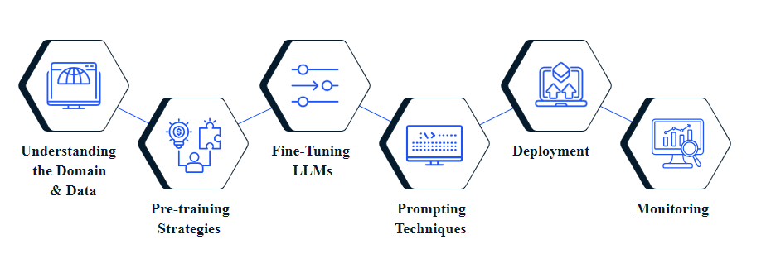
How to use LLMs for creating content-based recommendation systems for entertainment platforms?
Notes:
1. Understanding the Domain and Data
Understanding the Domain: Before getting into the technical stuff, it's important to grasp what entertainment platforms are all about. This includes knowing what users like, the kinds of content available (like movies, music, etc.), and what’s trending. This helps in making better recommendations.
Data Collection: Collect data about what users do and the details of the content (like genres, ratings, etc.). This data is essential for building a system that can recommend content users will enjoy.
2. Domain Analysis
Domain Analysis: You need to understand the specifics of the entertainment world. For example, knowing the types of movies or songs and what features make them popular. This understanding is crucial for creating systems that can recommend content based on user preferences or similar items.
3. Pre-training Strategies
Pre-training LLMs: Before using a Large Language Model (LLM) to recommend content, it must be trained on a lot of text data. Two common methods are:
Masked Language Modeling (MLM): The model learns by guessing missing words in a sentence.
Next Token Prediction (NTP): The model learns by predicting the next word in a sentence.
4. Fine-tuning for Entertainment Recommendations
Fine-tuning: After the model has learned general language skills, it’s adjusted (fine-tuned) to make it good at recommending entertainment content. Two ways to do this are:
Full-model Fine-tuning: Adjust the entire model to work well with entertainment data.
Parameter-efficient Fine-tuning (PEFT): Only change a small part of the model to save computing power while still making accurate recommendations.
5. Prompting Techniques
Prompting: This involves giving the model specific instructions (prompts) to help it make better recommendations. For example:
Conventional Prompting: Creating prompts that guide the model to generate recommendations in a specific format, like summarizing user reviews.
In-Context Learning (ICL): Teaching the model to make recommendations by providing it with examples or context during its usage.
6. Deployment and Continuous Improvement
Deploying and Improving the System: Once the model is trained and fine-tuned, it’s put to use in a real-world system. It’s important to keep checking how well it works, gather user feedback, and make updates to keep the recommendations relevant and accurate.
7. Leveraging LLM Capabilities in Entertainment Recommendations
Zero/Few-shot Recommendation Ability: This is the model’s ability to make recommendations even with little or no prior data. It’s useful for recommending new content that users haven’t interacted with before.
Cold-Start Problem: This problem occurs when there’s not enough data to make recommendations. LLMs can help solve this by using general knowledge or limited data to make predictions.
Explainable Ability: LLMs can explain why they’re recommending something, which helps users trust the recommendations and understand their preferences better.
8. Integration for Enhanced Recommendations
Combining Capabilities: By using both the zero/few-shot ability and the explainable ability, LLMs can provide personalized, understandable, and effective recommendations, even when data is limited. This leads to higher user satisfaction and engagement.

Slide 16
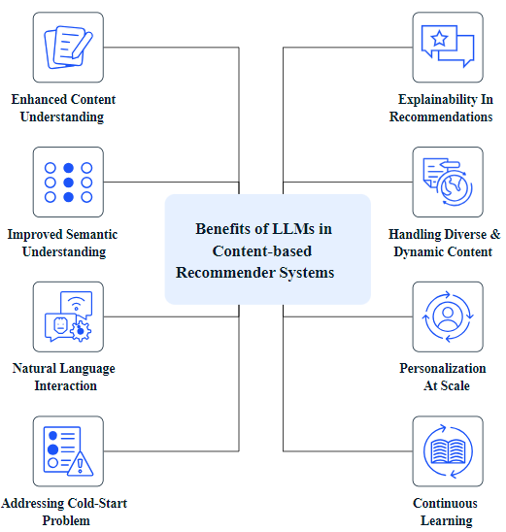
Benefits of LLMs in content-based recommender systems
Notes:
1. **Enhanced content understanding**:
LLMs (Large Language Models) are really good at understanding and generating text that feels human-like. When they're used in recommendation systems, they can understand the details and subtleties of the text that describes items (like songs or movies). This deeper understanding helps the system to more accurately identify what kind of content a user might like.
2. **Improved semantic understanding**:
Traditional recommendation systems often just match keywords to suggest content. LLMs go further by understanding the context and meaning behind the words. This means they can make better and more relevant suggestions because they understand the deeper connections between words and their meanings.
3. **Natural language interaction**:
LLMs allow users to interact with recommendation systems in a more conversational way, similar to talking with another person. This makes it easier for users to express what they want, ask for more specific suggestions, and receive recommendations in a way that feels natural and intuitive.
4. **Addressing the cold-start problem**:
When a new user or item is added to a system, there's often not enough data to make good recommendations—this is called the cold-start problem. LLMs are good at making predictions even with little information, which helps in making useful suggestions even when there isn’t much data to work with.
5. **Explainability in recommendations**:
LLMs can provide recommendations that are easier to understand and explain. This means users can see why a particular item was suggested to them, which helps build trust in the system because users understand the reasoning behind the recommendations.
6. **Handling diverse and dynamic content**:
In areas like entertainment, new content is always being created. LLMs are good at keeping up with these changes and can handle a wide range of different types of content, from movie summaries to user reviews. This makes them valuable in recommending fresh and diverse content.
7. **Seamless integration into existing pipelines**:
LLMs can be easily added to existing recommendation systems without requiring a major overhaul. They can enhance how content is understood or act as an additional layer of understanding, making the existing system smarter without needing to rebuild it from scratch.
8. **Personalization at scale**:
LLMs can personalize recommendations for many users at once by learning from large amounts of text data. They can pick up on what individual users like and tailor content suggestions to match their tastes, making the experience more engaging for everyone.
9. **Continuous learning and adaptation**:
LLMs can be updated with new data to keep up with changing user preferences and trends. This means that the recommendation system stays relevant and continues to suggest content that aligns with what users are currently interested in.
10. **Exploration of unseen content**:
LLMs are capable of suggesting content that isn’t popular or widely known, helping users discover new and unique items. This encourages users to explore beyond the usual suggestions and find content they might not have come across otherwise.

Slide 17
LLm models for music discovery
GPT (Generative Pre-trained Transformer) Models
Can analyze user preferences based on textual data, like song lyrics or user reviews
BERT (Bidirectional Encoder Representations from Transformers)
In a music streaming context, BERT can be used to analyze song lyrics, artist bios, and other textual metadata to find similar content.
Jukebox by OpenAI
While it's more about generating music, insights from such models can be used to understand music patterns and preferences.
RecBERT
A BERT-based model fine-tuned specifically for recommendation systems

Slide 18
Utilization of GPT
Lyric analysis
Textual metadata
Natural language interaction
Feedback Loop and Refinement
Curated Playlists
Notes:
Lyric Analysis: GPT can analyze the lyrics of songs to understand themes, emotions, and contexts. By embedding these lyrical contents, the system can recommend songs with similar themes or emotions based on user preferences.
Textual Metadata: GPT can process and generate embeddings for textual metadata like genre, artist description, and song descriptions. This allows the recommendation system to suggest similar songs based on metadata features.
Natural Language Interaction: GPT can allow users to interact with the recommendation system via natural language queries (e.g., "Play some upbeat music for working out"). The system can parse these requests and suggest songs that fit the context.
Mood-Based Recommendations: By analyzing user inputs, GPT can understand the user's current mood or context and recommend music accordingly.
Curated Playlists: GPT can generate curated playlists by understanding specific themes, moods, or contexts. For example, it can create a playlist for "rainy days" or "summer vibes" by identifying songs that fit these themes.
6. Feedback Loop and Refinement:
Dynamic Recommendations: GPT can refine recommendations in real-time based on user feedback. For example, if a user skips a song, the system can adjust the playlist dynamically to better match the user’s current preferences.

Slide 19
Utilization of Jukebox
Vector Embeddings
Contextual Recommendations
Genre & Style Matching
Novelty Detection
Notes:
Vector Embeddings: Jukebox generates embeddings for music tracks, capturing various aspects like genre, mood, tempo, and even the lyrics' content. These embeddings can be used to compare different songs and recommend similar ones to users.
Contextual Recommendations: By embedding not only songs but also user preferences (like listening history or mood), the recommendation system can align user profiles with specific music embeddings generated by Jukebox.
Genre & Style Matching: Jukebox's ability to generate music in different genres and styles means it can also distinguish between them. This can enhance content-based filtering by providing deeper insights into the music's characteristics.
Novelty Detection: Since Jukebox understands a wide variety of musical features, it can identify unique songs that a user might like, even if those songs are less mainstream.

Slide 20
How gpt can be utilized for our recommendation system
UNDERSTANDING THE ROLE OF GPT
DATA COLLECTION
PREPROCESSING THE DATA
FINE-TUNING GPT
MODEL INTEGRATION
ENHANCING RECOMMENDATIONS WITH USER FEEDBACK
EVALUATION AND TESTING
DEPLOYMENT AND SCALING
CONTINUOUS IMPROVEMENT

Slide 21
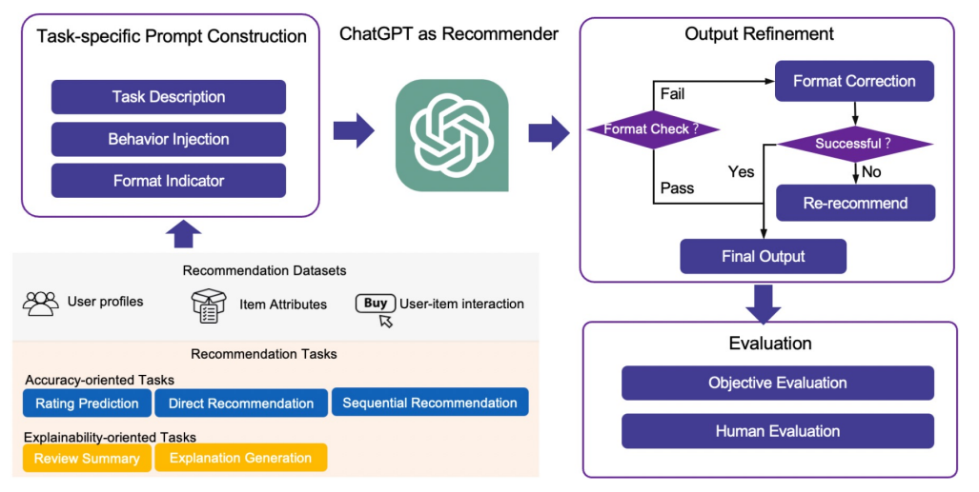
CHATGPT AS RECOMMENDER

Slide 22
THANK YOU
Utkarsh Singh

